Slide 1
From Relational to Hadoop
Part 2: Sqoop, Hive and Oozie
Gwen Shapira , Cloudera and Danil Zburivsky, Pythian

Slide 2
Previously we…
Loaded a file to HDFS
Ran few MapReduce jobs
Played around with Hue

Slide 3
Now its time to
Use Sqoop to extract data from MySQL
Create Hive table on JSON data
Join the two data sets
Run few aggregations
Load data back to MySQL
Sync everything through Oozie

Slide 4

wow
Much plans
So Hadoop!
Very practice

Slide 5
Important things about Sqoop

Slide 6
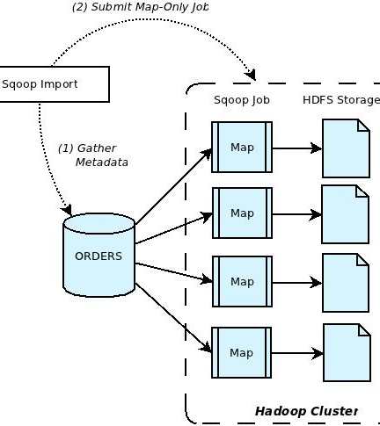
Reminder:
Sqoop gets metadata
Sqoop starts mappers
Each mapper runs a query
writes the result to HDFS

Slide 7
Sqoop is customizable
You can use a custom query
You can tune number of mappers (careful!)
You can tune the data split
You can use direct connectors for your DB
Notes:
Direct connectors are highly recommended. Using the MySQL connectors allow using MySQL dump to get the data instead of a query. This is significantly faster.

Slide 8

Sqoop vs Sqoop2
Sqoop
Sqoop2
Production
Client app
Plain text password
Lots of connectors
Beta
Client-server
Can store jobs, configs
Secure
No connectors yet
Notes:
Also, Sqoop changed quite a bit between versions. So make sure the stuff you are reading through google matches the version you are using. To make things more fun, Cloudera backports patches so CDH 4.5 arrives with Sqoop 1.4.3 that has few 1.4.4. features.

Slide 9
Lets Sqoop

Slide 10
Step 2 – Import with Sqoop
Start MySQL
List databases using Sqoop
List tables in database "world" using Sqoop
Load “cities_coords” table to HDFS
Load “cities_coords” table to Hive
Load “cities” table to Hive using Direct Connector

Slide 11
Tips
Sudo service mysqld start
“sqoop help” will give you list of commands
“sqoop import” is used to get data from the DB to Hadoop
Take a peek at ~/pl_tutorial/solutions/ex3-sqoop.txt and check the JDBC connection string
If /data doesn’t exist – either use an existing dir, or create it.

Slide 12
No worries
sqoop list-databases --connect jdbc:mysql://localhost --username root
sqoop list-tables --connect jdbc:mysql://localhost/world --username root
sqoop import --connect jdbc:mysql://localhost/world --username root --table cities_coords --warehouse-dir /data/world
sqoop import --connect jdbc:mysql://localhost/world --username root --table cities_coords --hive-import
sqoop import --connect jdbc:mysql://localhost/world --username root --table City --warehouse-dir /data/world2 --direct

Slide 13

About Hive

Slide 14
Hive – Not 100% SQL
Extras
Missing
Parallelism (duh)
Unstructured data
Columnar + Compression
Buckets (hash-partition)
Explode
Lateral-view
Nested data types
Xpath
Cube rollup
Support for subqueries
Non-equi-joins
Limited date-time support
No updates/deletes

Slide 15
Never Metadata I didn’t like
Hive has a metastore
Recommended: Put metastore in MySQL
Translate files into tables
Any file on HDFS can be a Hive table
External tables:
Datafile itself is not managed by Hive

Slide 16
SerDe
Instruct Hive on how to read/write data for a certain file format
JSON, CSV, XML, Avro, Parquet
SerDes are JAR files. Use “ADD JAR” to load the JAR in Hive

Slide 17
Hive Practice

Slide 18
Add the SerDe jar to the classpath using "add jar". List jars to validate.
Create an external table for accessing the earthquake data in HDFS using the JSON SerDE
Validate the table by selecting the first two rows. Then find the avg magnitude of earthquakes in our file
Find 10 most populated cities from our cities_coords table in Hive

Slide 19
Extra Credit!
5. Find top 10 cities and their population which have largest earthquakes in our data set. Select only cities that have population of more than 100 people.
Tips:
a. Use properties.place field to find which city is closest to eqrthquake epicenter
b. Use Hive regexp_extract to get city and state from string. Check Hive docs for examples -- https://cwiki.apache.org/confluence/display/Hive/LanguageManual+UDF
c. Join cities_coors table to get population

Slide 20
Create Table
Add jar ‘….’;
Create external table earthquakes (
type string,
properties STRUCT<
mag:string,
…..
)
ROW FORMAT SERDE ‘com.cloudera.hive.serde.JSONSerDe’
LOCATION ‘/etl/earthquakes/landing’

Slide 21
No need to load data
That’s the hadoop magic. Just query the JSON:
Select * from earthquakes
select avg(properties.mag) from earthquakes

Slide 22
select * from earthquakes limit 2;
select avg(properties.mag) from earthquakes;
select name, population from city order by population desc limit 10;

Slide 23
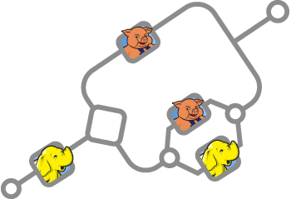
About Oozie

Slide 24
Oozie
Workflow orchestration
Why not just use … ?

Slide 25
Oozie + Hue
The easy way to use Oozie:
Use Hue to create workflows
Drag and drop actions

Slide 26
Oozie the Hard Way
Workflows are XMLs
<workflow-app xmlns="uri:oozie:workflow:0.2" name="map-reduce-wf">
<start to="mr-node"/>
<action name="mr-node">
<map-reduce>
<job-tracker>${jobTracker}</job-tracker>
<name-node>${nameNode}</name-node>
<configuration>
.....
</configuration>
</map-reduce>
<ok to="end"/>
<error to="fail"/>
</action>
<kill name="fail">
<message>Map/Reduce failed, error message[${wf:errorMessage(wf:lastErrorNode())}]</message>
</kill>
<end name="end"/>
</workflow-app>

Slide 27
Important Notes
Everything a workflow needs must be in HDFS
Job.properties configures everything Oozie client needs
Watch job status / errors in Hue
Oozie is best learned from example
So feel free to “peek” and play with the provided solution

Slide 28
Oozie Practice

Slide 29
0. Before we start: Drop the Hive table "City". We will be importing it again.
1. Oozie workflows can be executed from any node in the cluster. Therefore everything the workflow will need should be on HDFS.
Create /user/cloudera/workflow directory in HDFS and in it:
(see the list on the exercise text file)
2. create job.properties file - this file should include:
(see the list on the exercise text file)
3. Create workflow.xml file with the following workflow actions:
- Sqoop action to create Hive cities table
- Hive action to create external earthquakes table
- Hive action to create "top 10 most populated" cities
4. Copy workflow.xml to the workflow directory in HDFS.
And use oozie to execute the workflow

Slide 30
Parting Words

